Slide 1
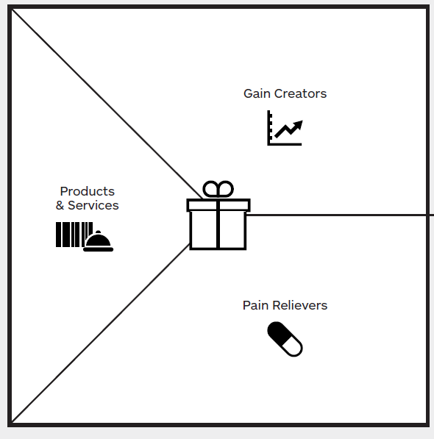
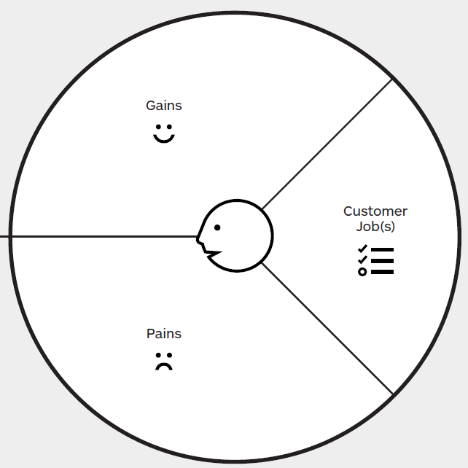
Better housing location
Tinder-like roommate searching & engine
Easy searching and comparing
Cheap Housing and Meals
Suitable roommates
Quick settling down
Better knowledge of potential roommate preference
Off-campus Housing Location
Housing App
Newsfeed of housing resources based on personal settings
Easy commute between home and campus
%empty
%empty
Roommate Pairing
Off-campus Housing Roommate Search
%empty
Housing Search and (Long-term Airbnb functions e.g. Rating, descriptions, reviews, blah)
Housing Furniture
Not familiar with the neighborhood
Dining (national cuisine)
Less Searching Time
Dangerous neighborhood
Housing Reviews and Community suggestions
%empty
Bad roommates
Housing resources sought by themselves not trustworthy
Improved Trust
%empty
%empty
Avoid bad housing choices
Optimized budget
Shocked by cultural environment?
Overcharged Housing etc.
Improved Trust/Face
More time for adaptation to neighborhood
Faster housing-related knowledge learning curve
Safety

Slide 2







The Business Model Canvas
International Student Community
Incoming (International) students
Oversea educational institutions
Development and maintenance of platform
Search performance
Customer Reviews (Co-creation)
University
Automated Info (FAQ)
Find housing
Veteran? (International) Students
Coder
App Store (Web)
Moderator & Arbitrator
Landlord / householder
Server maintenance
Advertising (or coupon-styled)
Labor
Processing Fee
Promotion of housing resources
Advertising

